Slide 1


MAJOR PROJECT PRESENTATION
Group No-87

Slide 2
TABLE OF CONTENTS
01
02
03
ABOUT THE PROJECT
Tech Stack
Google Colab & Machine Learning
04
05
06
Research Area
Project Goals
OUR TEAM

Slide 3
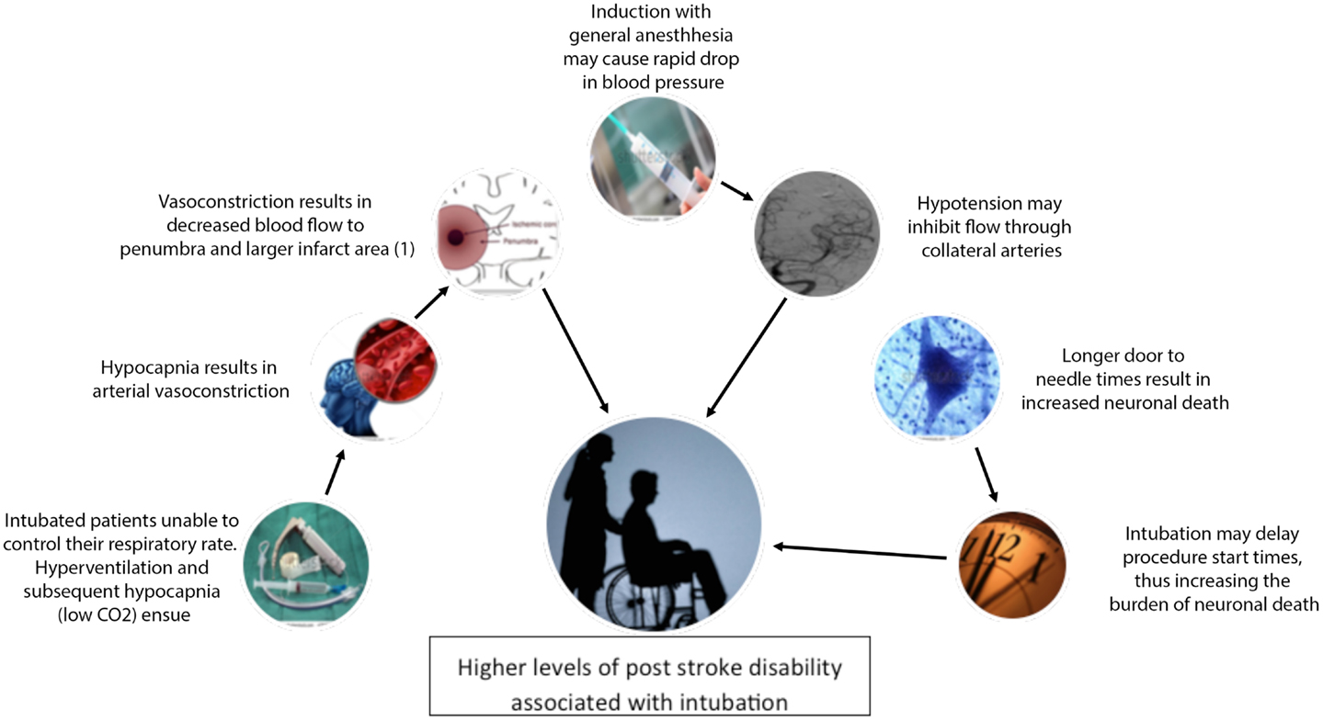
ABOUT THE PROJECT
In this project we are creating a Heart Stroke Prediction Machine Learning Model as now a days strokes are global health concerns, demanding swift medical attention due to it’s severity & high mortality rates.

Slide 4
WHAT WE ARE WORKING ON
We are proposing a Machine learning model which can predict and detect whether a person can have a heart stroke in future or not.
The datasets that we are using have several parameters such as age, sex, resting blood pressure, cholesterol level, echocardiogram data, exercise habits hypertension, heart disease history and many others.
We will use several algorithms so that we can the make the prediction even of that person whose some data parameters are missing.

Slide 5
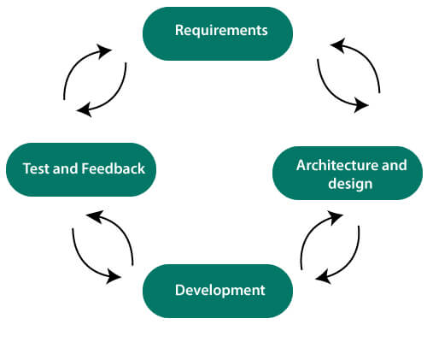
TECH STACK
Programming Languages
Datasets for Training & Testing
Machine Learning
Platform – Google Colab

Slide 6
Why we are using Google Colab?
Free GPU access
Code
Integrate and test
Pre-installed Libraries
Valuable for projects that involve deep-learning and have large datasets.
Implementing
Python code
Combine all the code, train and test the model .
Saves time on environment setup.

Slide 7
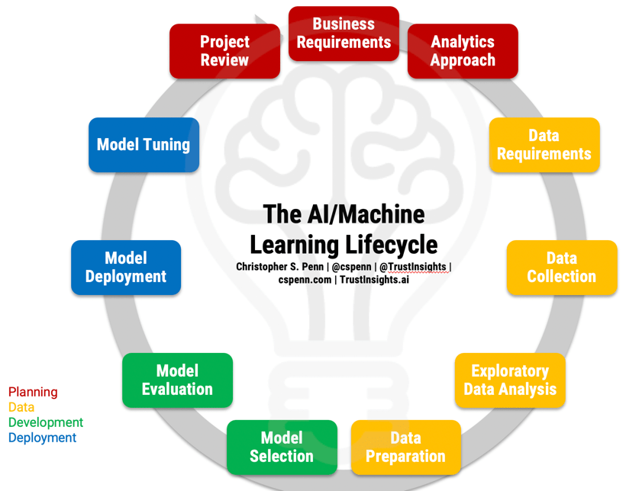
Machine Learning
Machine Learning is a subfield of AI that focuses on the development of algorithms and statistical models that enable computer system to learn and improve their performance on a specific task over time without being explicitly programmed.
It involves the analysis of data to discover patterns, make predictions or automate decision-making which makes it a powerful tool for various applications.

Slide 8
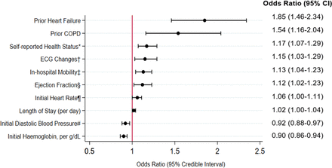
Datasets in Machine Learning
In machine learning, datasets are essential for training, testing, and evaluating models. It consist of collections of data samples, where each sample typically include input features and corresponding labels for supervised learning and target values.

Slide 9
Research Area While we are making a Heart Stroke Prediction Machine Learning Model we have several areas for research like Medical Data Analysis, Feature Engineering, Predictive Modelling, Deep Learning for Medical Field, Early Warning Systems, Comparative Analysis and Patient Engagement and Education. We can go with any of them for Research as all are important for both medical & engineering field.

Slide 10
PROJECT GOALS
GOAL 1
GOAL 2
Developing a predictive model that can aid in early detection & prevention of Heart Strokes.
It involves understanding and implementation of various machine learning algorithms, which can be a great opportunity for us to enhance our machine learning skills.

Slide 11

MONTHLY TIMELINE
September
November
December
October
Apply these algorithms on dataset to train and test the model.
We started the project.
Work on different datasets and learn about algorithms.
We will do the research work & complete 20% project.

Slide 12
OUR TEAM
Divyansh Sharma Garima Yadav Muskan Sharma Priyansh Sharma

Slide 13

THANK
YOU!!!!!

